Slide 1
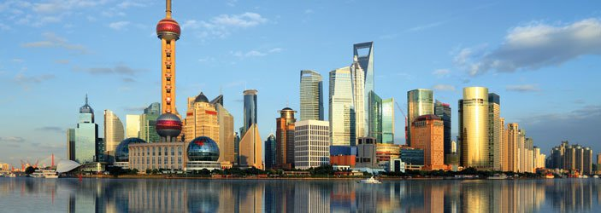
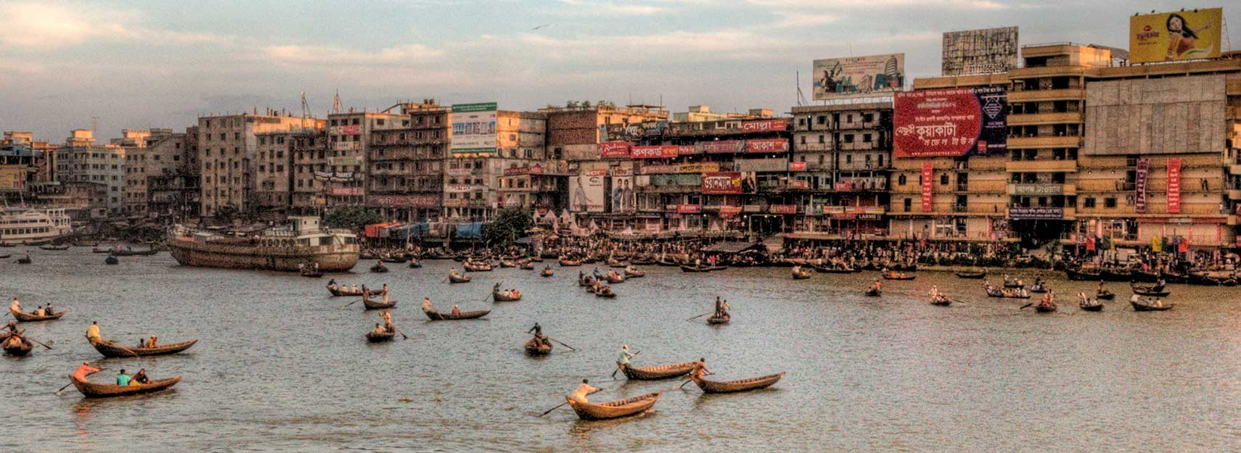

In which city would you want to live?
Be prepared to explain why.
Learning Links

Slide 2
Key question / Learning outcomes
Section A: Urban Issues and Challenges
What is a megacity?
Key idea | Specification content
A growing percentage of the world’s population lives in urban areas. | The global pattern of urban change. The emergence of megacities.
LEARNING OUTCOME…
Identify global population statistics.
Describe the way of life in two different megacities.
Explain the effects of the creation of megacities.

Slide 3
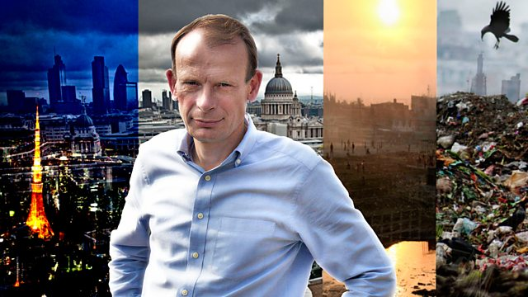
Introducing urban issues and challenges…
As an introduction to our new unit you will be watching a documentary about megacities to understand some of the global changes, trends, and consequences of urban issues.
During the video, answer the questions on your sheet.
Activity

Slide 4


Reflection
In just 20 words summarise something you have learnt about cities and mega cities.
Notes:
Image source: rlv.zcache.co.uk

Slide 5
Further Reading
http://www.bbc.co.uk/programmes/b011qmcl
http://www.bbc.co.uk/bitesize/intermediate2/geography/human_environments/world_population_distribution/revision/4/

